Slide 1
V. MOHANA PRIYA
FINAL PROJECT
Object Detection And Recognition

Slide 2
PROJECT TITLE
OBJECT DETECTION AND RECOGNITION

Slide 3
AGENDA
Data Augmentation: Leveraging generative models to augment training data.
Anomaly Detection: Utilizing generative AI for detecting anomalies in object recognition
Unsupervised Learning: Exploring unsupervised techniques for object detection.
Domain Adaptation: Adapting object detection models across different domains using generative AI.

Slide 4
PROBLEM STATEMENT
Leveraging generative AI techniques to enhance object detection and recognition systems by addressing issues such as limited training data, anomaly detection, unsupervised learning, and domain adaptation, ultimately improving the robustness and adaptability of these systems in real-world scenarios.
Data Augmentation: Using generative AI to augment training data for more robust object detection and recognition models.
Improving Anomaly Detection: Leveraging generative AI techniques to enhance anomaly detection capabilities within object recognition systems.

Slide 5
PROJECT OVERVIEW
Objective: Develop a generative AI model for real-time object detection and recognition in images and videos.
Approach: Utilize state-of-the-art generative adversarial networks (GANs) combined with convolutional neural networks (CNNs) to generate realistic images and accurately detect objects within them.
Data Preparation: Curate and preprocess a large dataset of annotated images to train the model, ensuring diversity and quality in the training data.
Evaluation: Assess the model’s performance using standard metrics such as mean average precision (mAP) and accuracy, comparing it against existing object detection methods to demonstrate its efficacy in generative AI applications.

Slide 6
END USERS
End users for object detection and recognition in generative AI include,
Autonomous vehicle developers
Surveillance companies
Retail marketers
Healthcare institutions
Manufacturing industries
Manufacturing industries
Smart city initiatives, and entertainment/gaming developers.

Slide 7
SOLUTION AND IT’S VALUES PROPORTION
The solution of object detection and recognition in GAN AI offers significant value by leveraging the capabilities of generative adversarial networks (GANs).
GAN AI enables the creation of realistic images and enhances the accuracy of object detection and recognition tasks.
By harnessing the power of GANs, this solution provides unparalleled accuracy and efficiency, while also fostering innovation in visual recognition technology.
Its ability to generate synthetic data for training further improves scalability and adaptability, making it invaluable for various industries and applications.

Slide 8
VALUE PROPORTION AND CONTINUATION
Improved Accuracy: Leveraging realistic synthetic data, GANs enhance the accuracy of object detection models, leading to more precise identification of objects in various scenarios.
Enhanced Accuracy: Through the generation of realistic synthetic data, GAN AI improves the accuracy of object detection models.
Privacy Preservation: GAN AI enables the creation of synthetic data, reducing the need for sensitive real-world data and preserving privacy in object detection tasks.
Innovation: GAN AI fosters innovation by facilitating the development of novel approaches and techniques for object detection and recognition, pushing the boundaries of computer vision capabilities.

Slide 9
UNIQUENESS IN SOLUTION
Data Augmentation: GANs can be used to generate synthetic data to augment existing datasets for training object detection and recognition models. This can help in scenarios where real data is scarce or expensive to collect.
Domain Adaptation: GANs can be employed for domain adaptation, where they generate synthetic data to bridge the gap between different domains, such as day and night images or images from different sensors. This can improve the robustness of object detection and recognition models in varied environments.
Adversarial Training: By incorporating adversarial training techniques, GANs can help in training more robust object detection and recognition models that are resistant to adversarial attacks.

Slide 10
MODELING
Involves locating and classifying objects within images or video frames. Techniques include R-CNN, YOLO, SSD. Object recognition identifies what objects are in the scene.
Consists of a generator and discriminator. Trained simultaneously in a competitive process. Generator creates synthetic data, discriminator distinguishes real from fake. Applications include generating realistic images, data augmentation, style transfer.

Slide 11
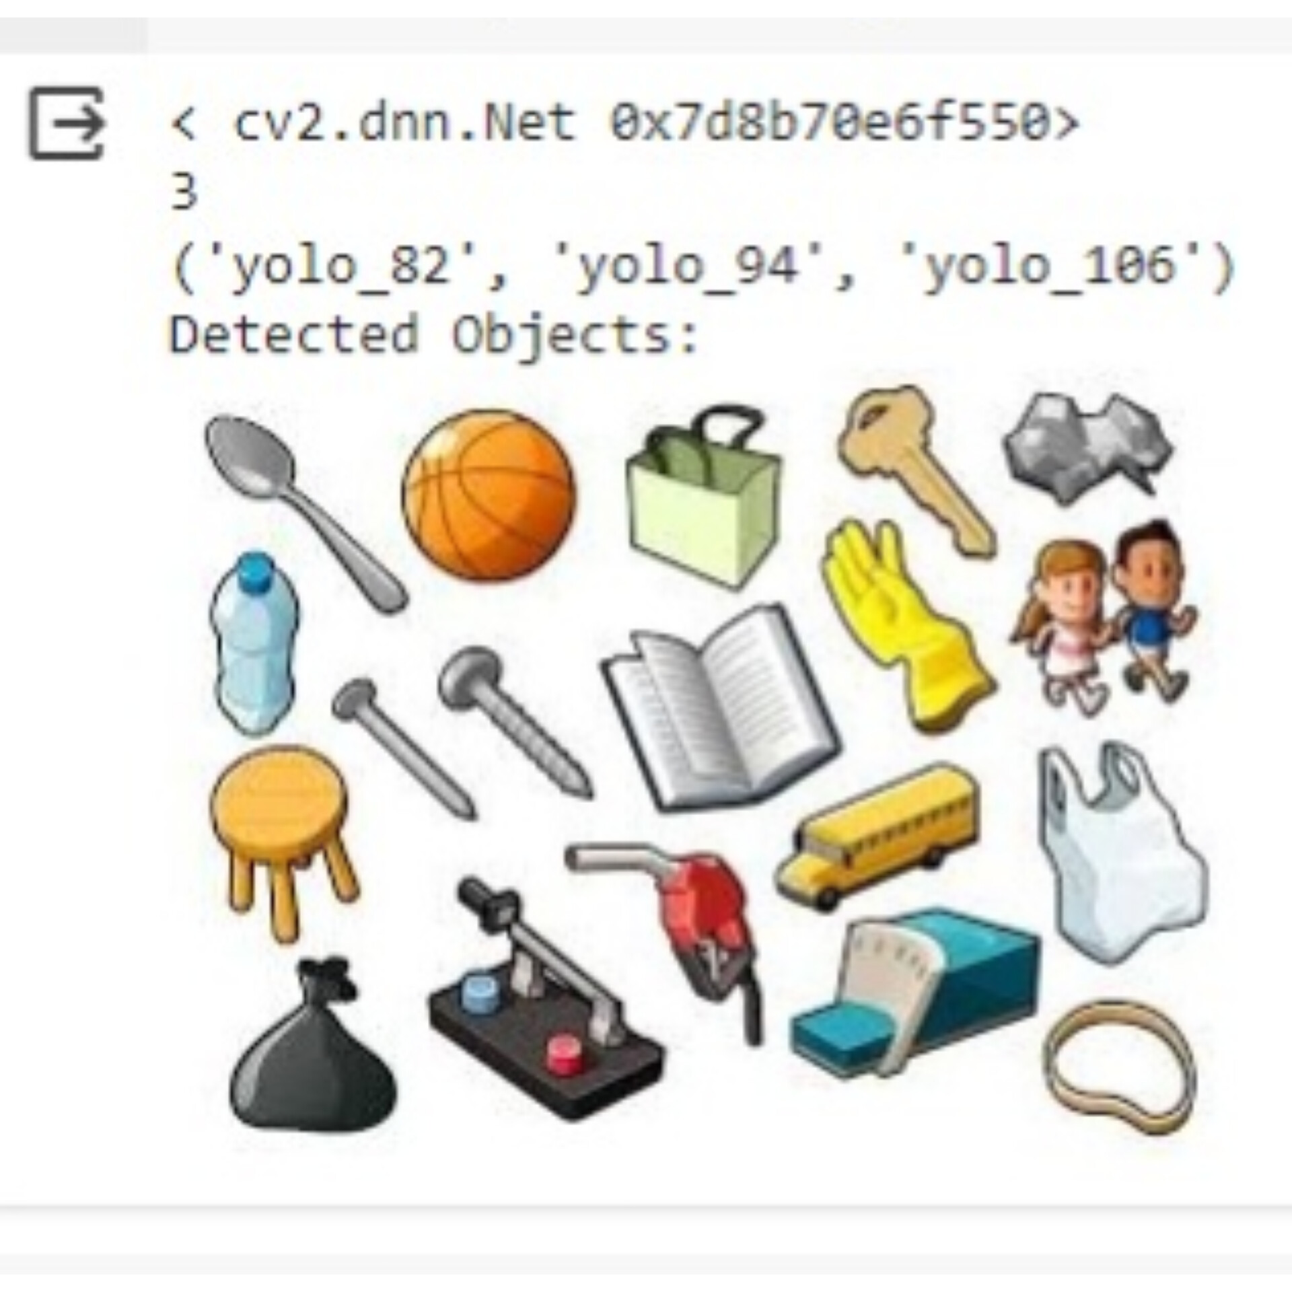
RESULTS

Slide 12
THANK YOU
Presented by : V. MOHANA PRIYA

